Slide 1


MOOC Evaluation System
Kumar Harshad 2011CS013
Naman Chhabra 2011CS1019
Prakhar Asthana 2011CS1027
Swapnil Godbole 2011CS1037

Slide 2


Slide 3





YOU – as a MOOC Instructor
Course Registration
Video Lectures
Course Slides
Discussions
Evaluation ???

Slide 4


Use Cases
Instructor
Create a course
Create an exam
View results of an exam
View previous courses
Delete a course
Delete an exam
Student
Take Exam

Slide 5
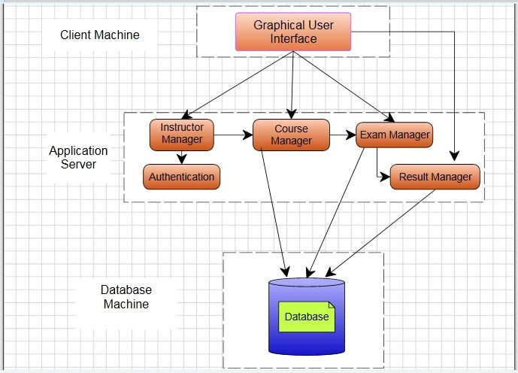
Logical View

Slide 6




Physical View
Internet
Clients
Web Server
Database

Slide 7
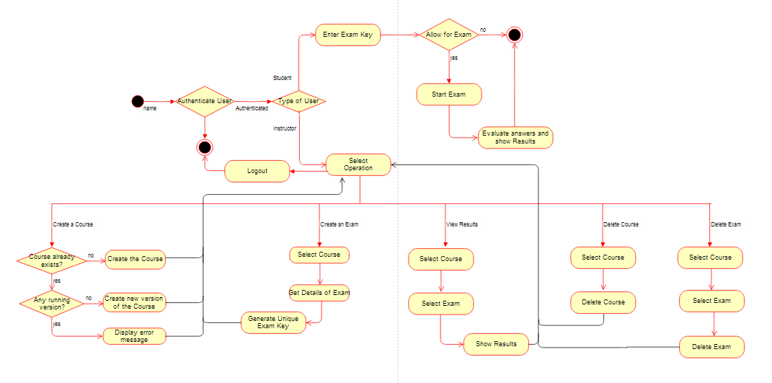
Activity Diagram

Slide 8
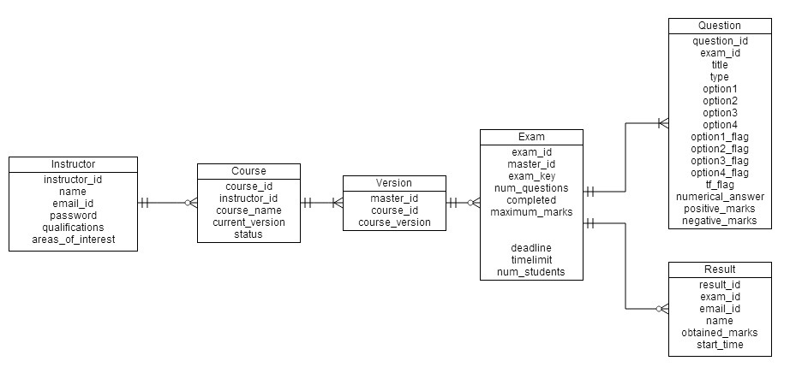
ER Diagram

Slide 9
New features in version 2.0
Google accounts for authentication (improved security)
Registration of institutes
More flexibility in setting tests e.g. time limit, more type of questions.
More flexibility in taking tests e.g. marking questions to do them later.

Slide 10
Technologies used
PHP
MySQL
JavaScript
AJAX
Apache web server

Slide 11


